Slide 1
Joe Barcus
Ashwini Devkota
Vivian Plasencia
Dylan Rossi
Heather Solis
Game 1 Analysis

Slide 2
Technologies Used
NHL API
MongoDB
Python
HTML/CSS/JavaScript
Heroku

Slide 3
Game Data
NHL dumps ~18,000 line JSON objects of every game on their undocumented API
Use GameID to hit the correct route
Creates an array of objects for each shot, hit, and goal
Object properties were players, the type of event, and coordinates.

Slide 4
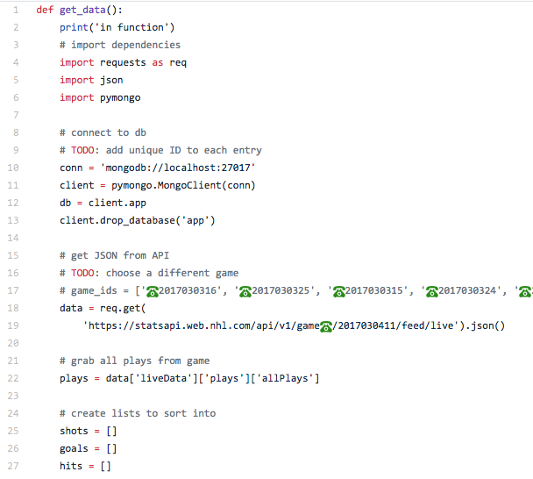
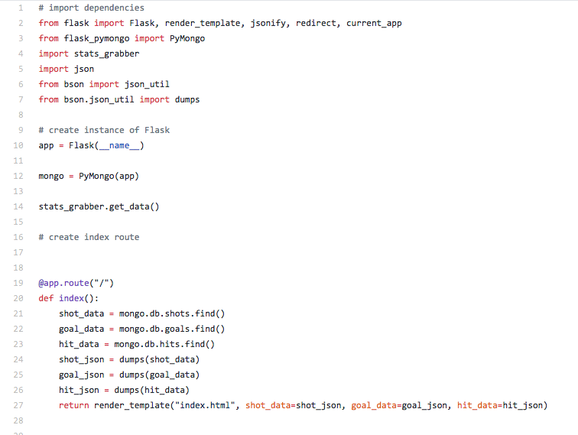
Game Data

Slide 5
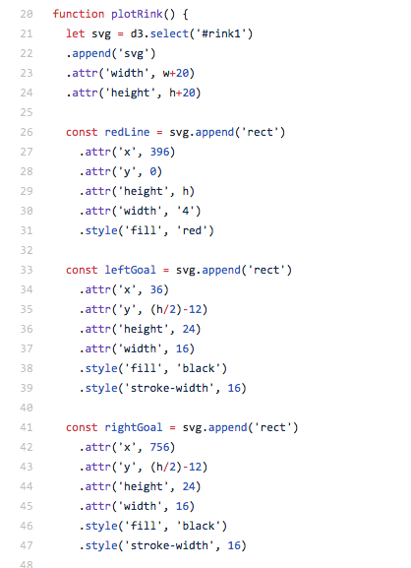
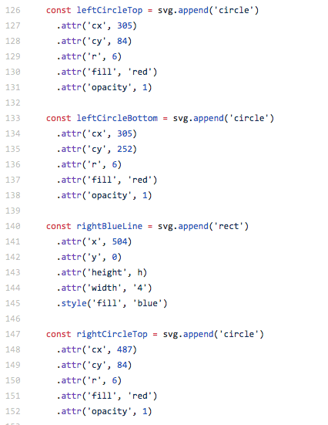
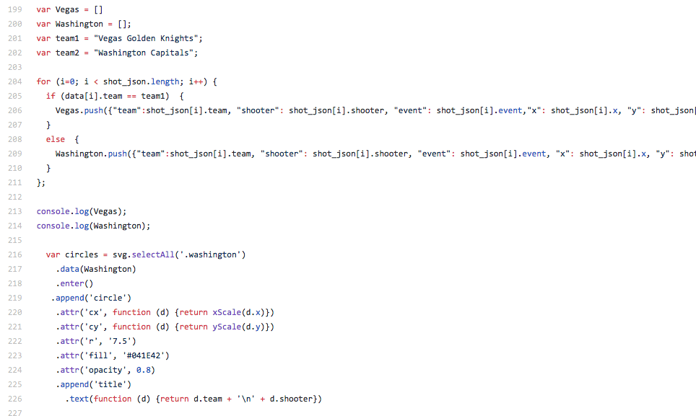
Build the Rink

Slide 6
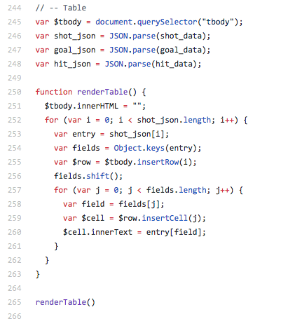
Build the DataTable

Slide 7
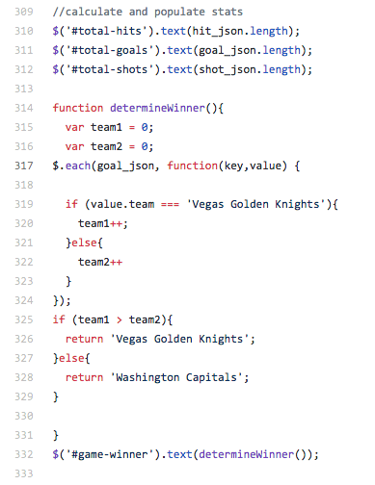
Calculating & Populating Stats Bubbles

Slide 8
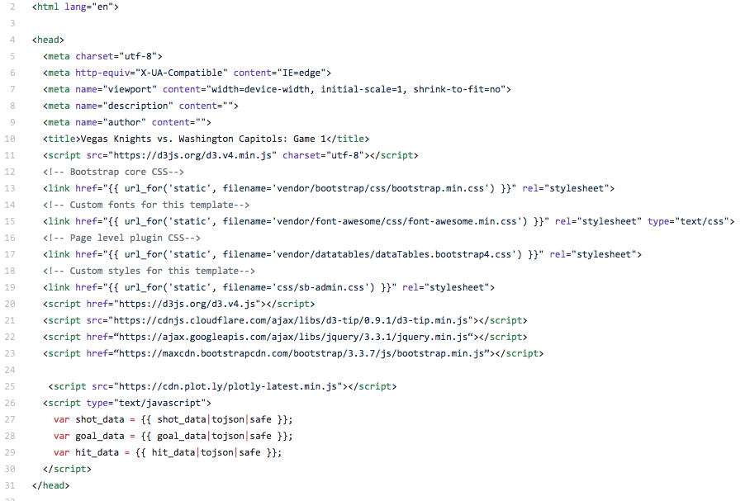
Build the Dashboard

Slide 9
Build the Bar Chart

Slide 10
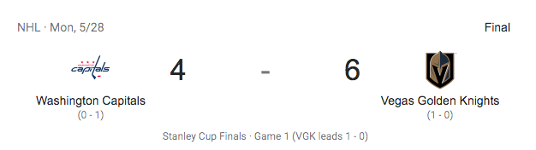
Vegas Knights Win!

